Slide 1
Data Warehouse

Slide 2
Index
OLAP vs OLTP
What is data warehouse
BigQuery
Cost
Partitions and Clustering
Best practices
Internals
ML in BQ

Slide 3
OLAP vs OLTP
 | OLTP | OLAP
Purpose | Control and run essential business operations in real time | Plan, solve problems, support decisions, discover hidden insights
Data updates | Short, fast updates initiated by user | Data periodically refreshed with scheduled, long-running batch jobs
Database design | Normalized databases for efficiency | Denormalized databases for analysis
Space requirements | Generally small if historical data is archived | Generally large due to aggregating large datasets

Slide 4
 | OLTP | OLAP
Backup and recovery | Regular backups required to ensure business continuity and meet legal and governance requirements | Lost data can be reloaded from OLTP database as needed in lieu of regular backups
Productivity | Increases productivity of end users | Increases productivity of business managers, data analysts, and executives
Data view | Lists day-to-day business transactions | Multi-dimensional view of enterprise data
User examples | Customer-facing personnel, clerks, online shoppers | Knowledge workers such as data analysts, business analysts, and executives

Slide 5
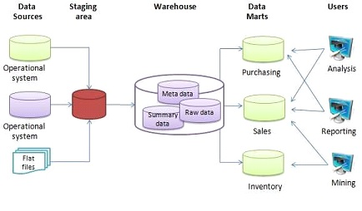
What is a data warehouse
OLAP solution
Used for reporting and data analysis

Slide 6
BigQuery
Serverless data warehouse
There are no servers to manage or database software to install
Software as well as infrastructure including
scalability and high-availability
Built-in features like
machine learning
geospatial analysis
business intelligence
BigQuery maximizes flexibility by separating the compute engine that analyzes your data from your storage

Slide 7
BigQuery Cost
On demand pricing
1 TB of data processed is $5
Flat rate pricing
Based on number of pre requested slots
100 slots → $2,000/month = 400 TB data processed on demand pricing

Slide 8
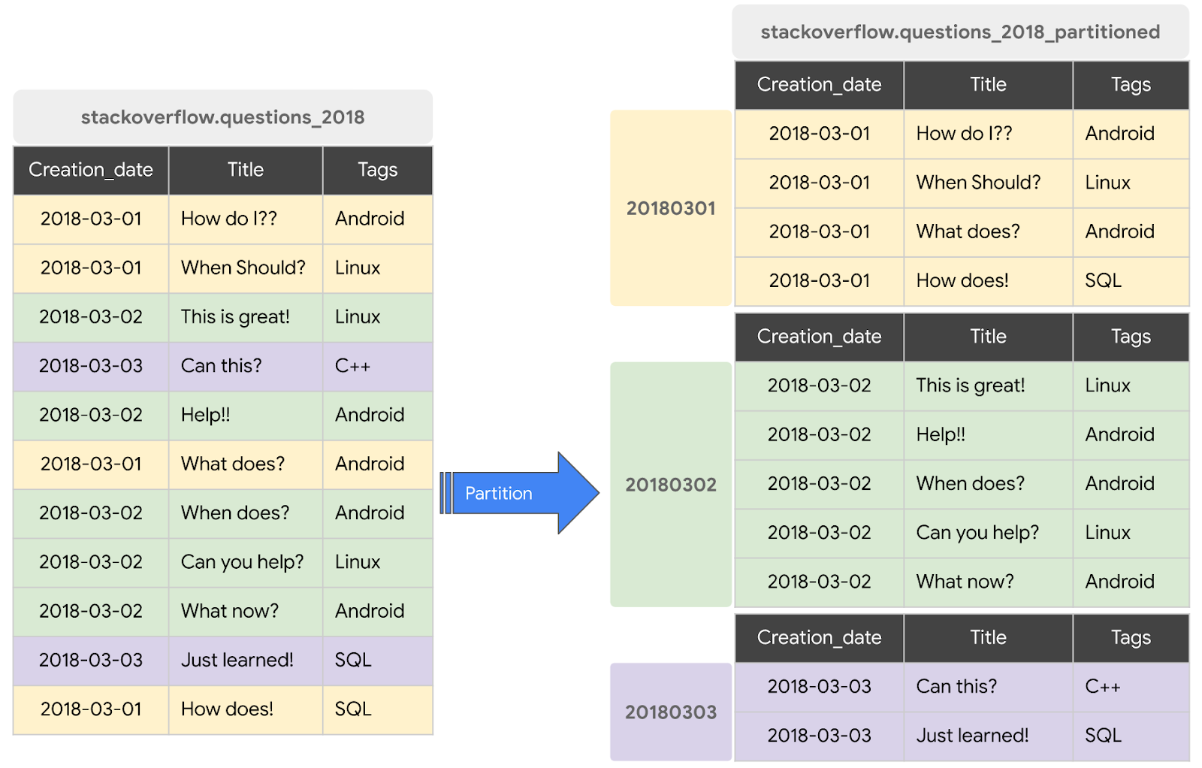
Partition in BQ

Slide 9
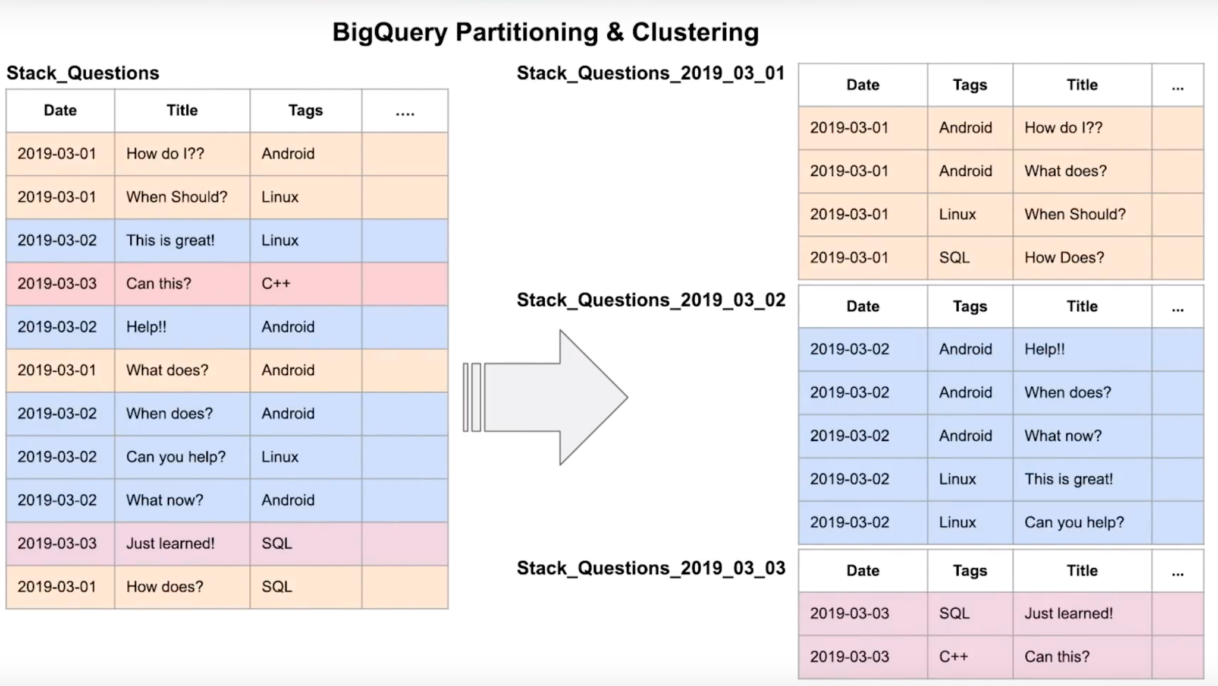
Clustering in BigQuery

Slide 10
BigQuery partition
Time-unit column
Ingestion time (_PARTITIONTIME)
Integer range partitioning
When using Time unit or ingestion time
Daily (Default)
Hourly
Monthly or yearly
Number of partitions limit is 4000
Resource: https://cloud.google.com/bigquery/docs/partitioned-tables

Slide 11
BigQuery Clustering
Columns you specify are used to colocate related data
Order of the column is important
The order of the specified columns determines the sort order of the data.
Clustering improves
Filter queries
Aggregate queries
Table with data size < 1 GB, don’t show significant improvement with partitioning and clustering
You can specify up to four clustering columns

Slide 12
BigQuery Clustering
Clustering columns must be top-level, non-repeated columns
DATE
BOOL
GEOGRAPHY
INT64
NUMERIC
BIGNUMERIC
STRING
TIMESTAMP
DATETIME

Slide 13
Partitioning vs Clustering
Clustering | Partitoning
Cost benefit unknown | Cost known upfront
You need more granularity than partitioning alone allows | You need partition-level management.
Your queries commonly use filters or aggregation against multiple particular columns | Filter or aggregate on single column
The cardinality of the number of values in a column or group of columns is large

Slide 14
Clustering over paritioning
Partitioning results in a small amount of data per partition (approximately less than 1 GB)
Partitioning results in a large number of partitions beyond the limits on partitioned tables
Partitioning results in your mutation operations modifying the majority of partitions in the table frequently (for example, every few minutes)

Slide 15
Automatic reclustering
As data is added to a clustered table
the newly inserted data can be written to blocks that contain key ranges that overlap with the key ranges in previously written blocks
These overlapping keys weaken the sort property of the table
To maintain the performance characteristics of a clustered table
BigQuery performs automatic re-clustering in the background to restore the sort property of the table
For partitioned tables, clustering is maintained for data within the scope of each partition.

Slide 16
BigQuery-Best Practice
Cost reduction
Avoid SELECT *
Price your queries before running them
Use clustered or partitioned tables
Use streaming inserts with caution
Materialize query results in stages

Slide 17
BigQuery-Best Practice
Query performance
Filter on partitioned columns
Denormalizing data
Use nested or repeated columns
Use external data sources appropriately
Don't use it, in case u want a high query performance
Reduce data before using a JOIN
Do not treat WITH clauses as prepared statements
Avoid oversharding tables

Slide 18
BigQuery-Best Practice
Query performance
Avoid JavaScript user-defined functions
Use approximate aggregation functions (HyperLogLog++)
Order Last, for query operations to maximize performance
Optimize your join patterns
As a best practice, place the table with the largest number of rows first, followed by the table with the fewest rows, and then place the remaining tables by decreasing size.

Slide 19
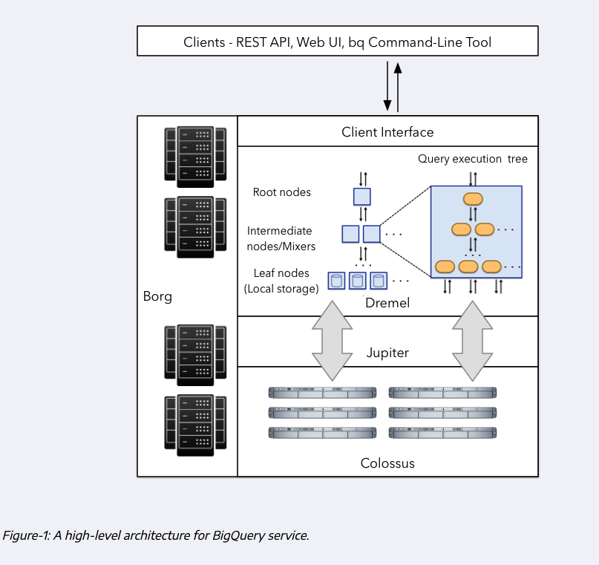
Internals

Slide 20
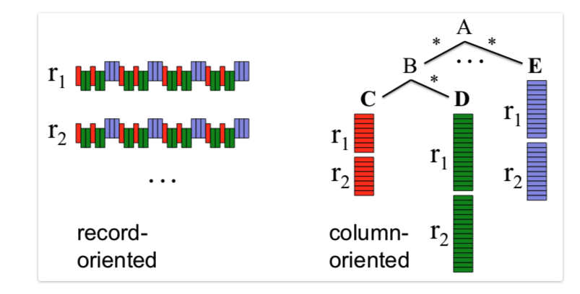
Internals

Slide 21
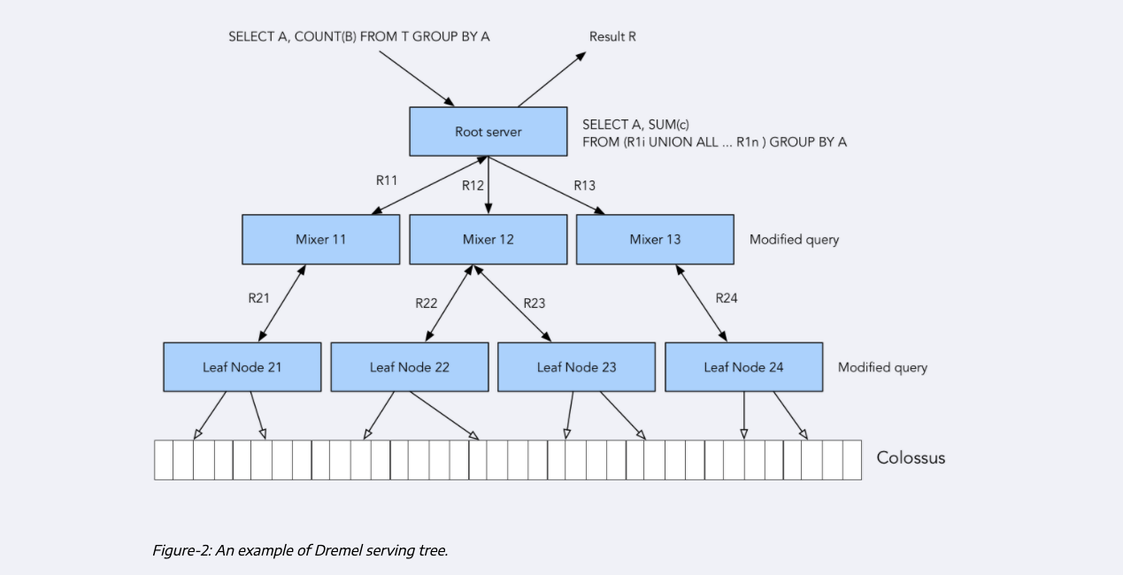
Internals

Slide 22
Reference
https://cloud.google.com/bigquery/docs/how-to
https://research.google/pubs/pub36632/
https://panoply.io/data-warehouse-guide/bigquery-architecture/
http://www.goldsborough.me/distributed-systems/2019/05/18/21-09-00-a_look_at_dremel/

Slide 23
ML in BigQuery
Target audience Data analysts, managers
No need for Python or Java knowledge
No need to export data into a different system

Slide 24
ML in BigQuery pricing
Free
10 GB per month of data storage
1 TB per month of queries processed
ML Create model step: First 10 GB per month is free

Slide 25
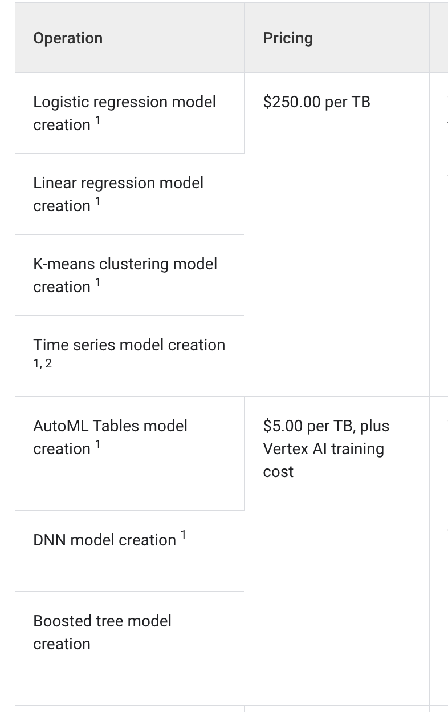
ML in BigQuery pricing

Slide 26
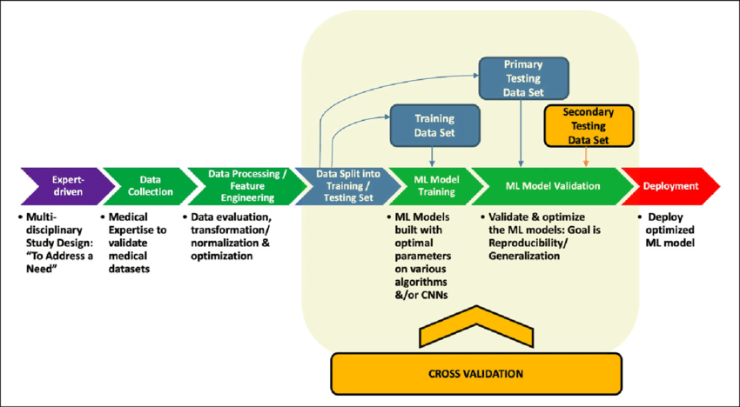
ML in BigQuery

Slide 27
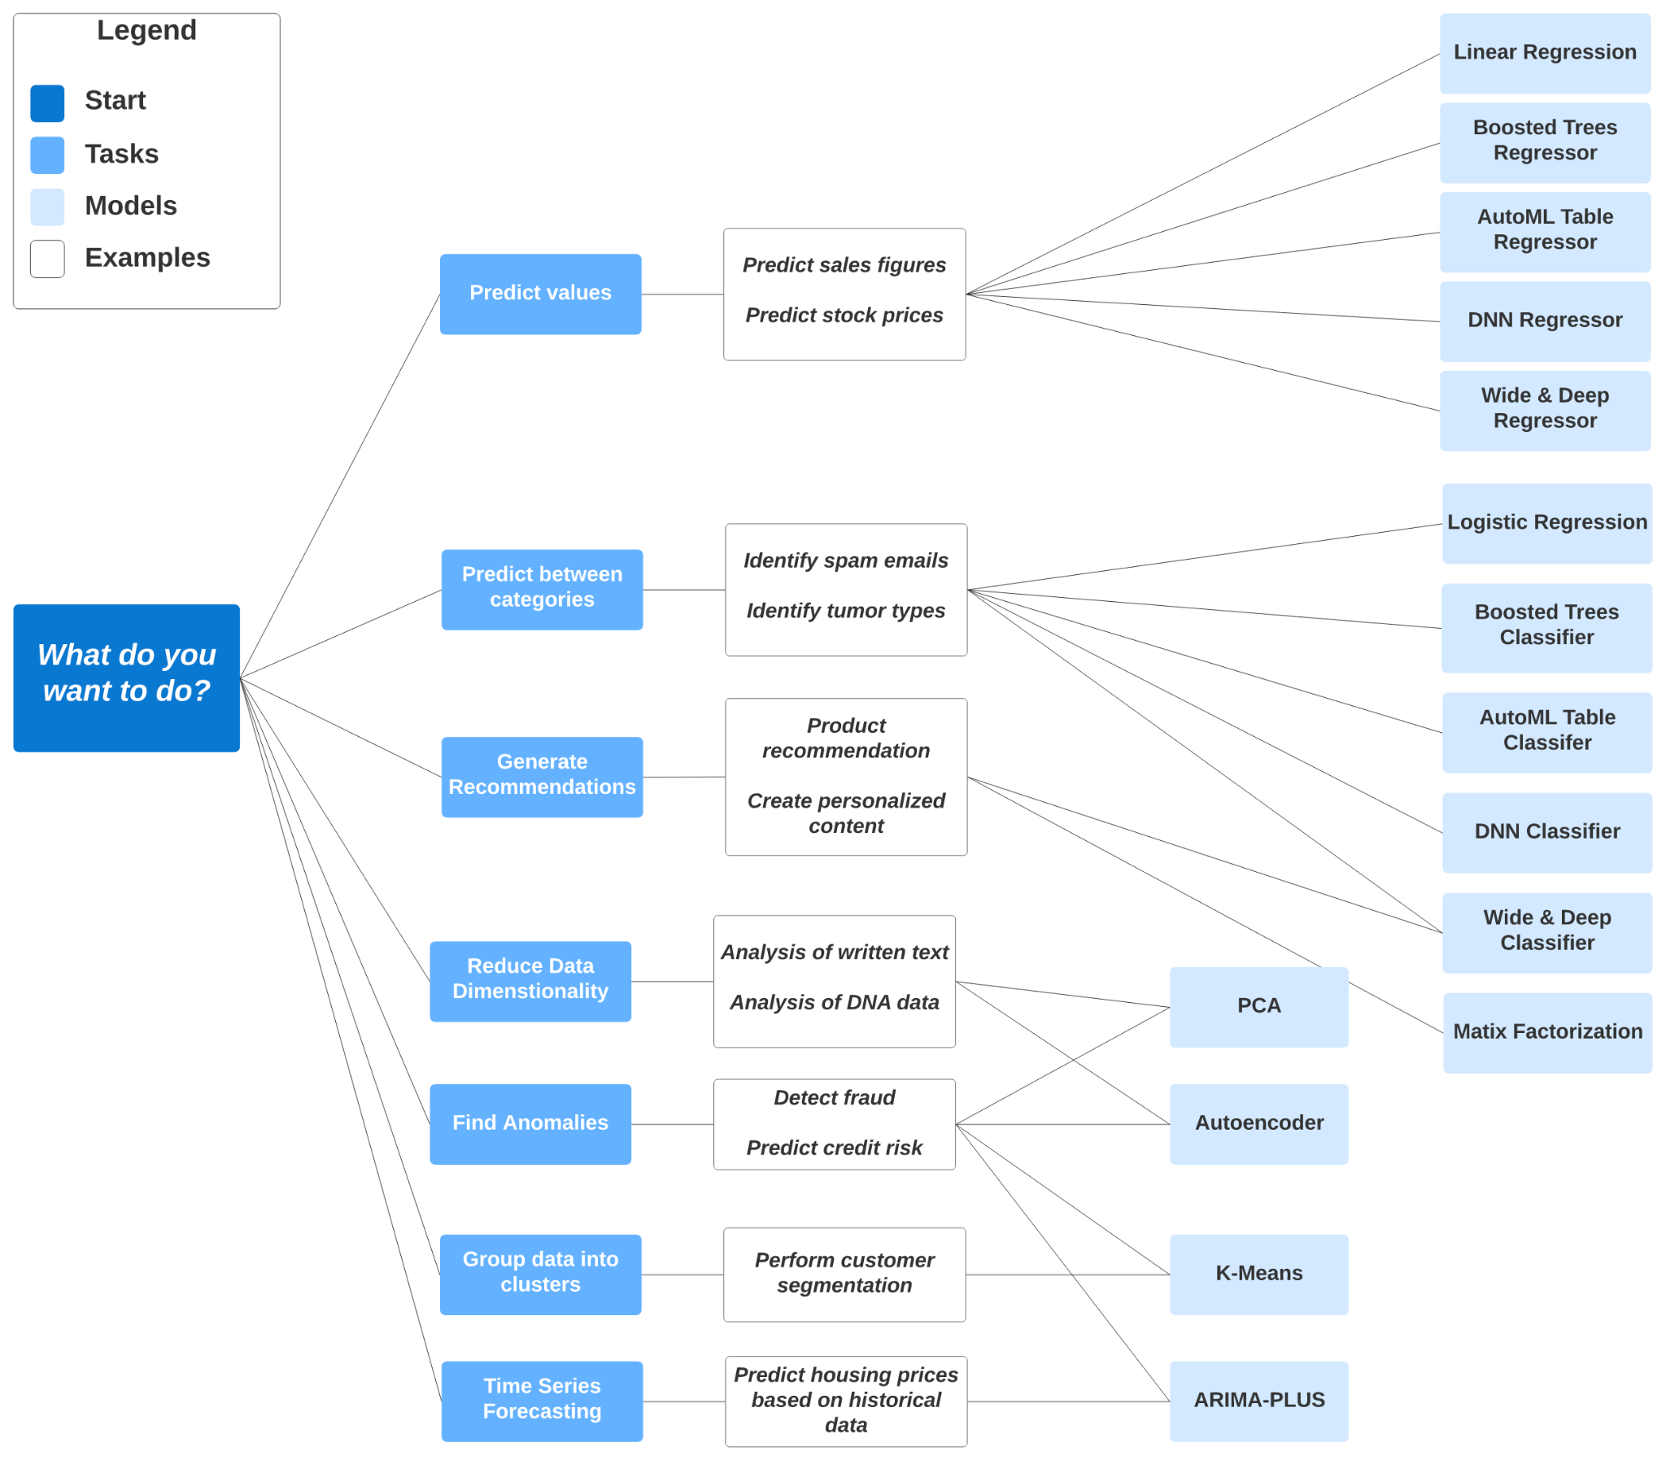
ML in BigQuery

